Slide 1
Primitives and Hierarchical Modeling
CS 460: COMPUTER GRAPHICS

Slide 2
Outline
Graphics Primitives: Points, Lines, and Triangles
Data structure: vertex list and index list
Hierarchical structure
Model+View or Modelview transformations
Basic scenegraph concept

Slide 3
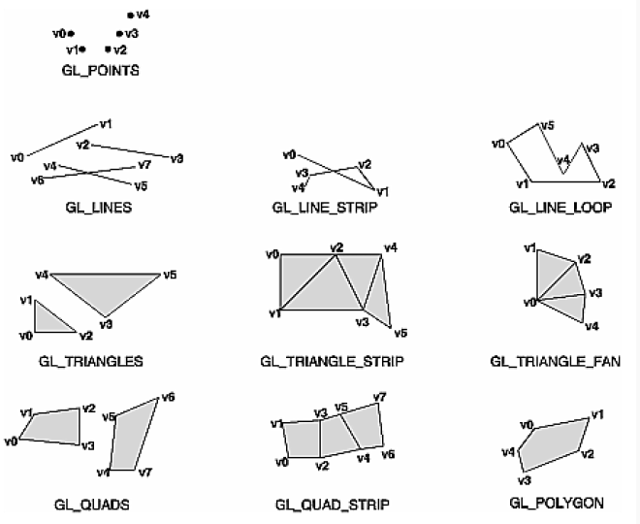
Graphics primitives
It’s all about
coordinates
and connectivity
glBegin ( type ) ;
glVertex ( … ) ;
glVertex ( … ) ;
glVertex ( … ) ;
……
glEnd() ;
Notes:
http://www.youtube.com/watch?v=C7K_GglsIUE

Slide 4
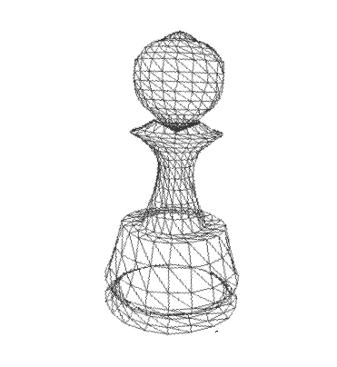
Graphics primitives
glBegin ( type ) ;
glVertex3f ( … ) ;
glVertex3f ( … ) ;
glVertex3f ( … ) ;
……
glEnd() ;
(x, y, z, 1)
A 3D Mesh
(shown as a wireframe)

Slide 5
Graphics primitives
glBegin ( type ) ;
glVertex3f ( … ) ;
glVertex3f ( … ) ;
glVertex3f ( … ) ;
……
glEnd() ;
tessellation / triangulation
Break
down
Points (GL_POINTS)
OR Lines (GL_LINE*)
OR Triangles (other)
Geometry Engine
A 3D Mesh
* Why triangles? We will see this later in the scan conversion lecture

Slide 6
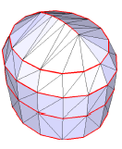
Graphics primitives
Question: which input type is the most
efficient one for rendering polygons?
  Triangle strip (preferred) or Triangle fan
  Because more polygons with fewer input vertices and no tessellation needed
  Some software to break down a 3D mesh into triangle strips for efficient rendering
  Can reuse processed vertices using a vertex cache on the GPU
Example: four tri. strips

Slide 7
Random triangle order
FIFO cache holding 6 vertices
~3 v/triangle

Slide 8
Long triangle strips
Trivial x3 improvement
~1 v/triangle

Slide 9
Vertex caching
i.e. all vertices of triangle can be found in cache
# misses
0
1
2
3
traditional strips
with caching
transfer ~1.0 vertex/tri
transfer ~0.5 vertex/tri

Slide 10
Data structure
(1) Vertex set (storing one array with vertex coordinates)
Vertex List
Vertex #
Coordinates
1
x1,y1,z1
Triangle number 1
2
x2,y2,z2
3
x3,y3,z3
4
x4,y4,z4
Triangle number 2
5
x5,y5,z5
6
x6,y6,z6
7
x7,y7,z7
8
x8,y8,z8
Good: sequential memory access
Bad: it is very likely to have duplicated vertices in the list

Slide 11
Data structure
(2) Indexed Face Set (one more array for indices)
Vertex List
e.g. float coords[N][3];
int tri_index[N][3];
Face List
Vertex #
Coordinates
a mesh
1
x1,y1,z1
2
x2,y2,z2
Polygon #
Vertex List
3
x3,y3,z3
1
V1,V2,V3
4
x4,y4,z4
2
V1,V4,V8
5
x5,y5,z5
3
V5,V6,V2
6
x6,y6,z6
4
V2,V6,V7
7
x7,y7,z7
5
V4,V3,V8
Need delimitors (-1) or an
additional field for Vertex
count if number of vertices
per polygon is flexible
8
x8,y8,z8
6
V5,V8,V7
Bad: random memory access
Good: reuse vertices and keeps a compact Vertex list

Slide 12
Notes
Triangle strip can be implemented on either data structure
Some high level APIs like VRML, Inventor, etc. have these data structure in-built and we can input the two lists directly
The Vertex ID of the first vertex in the vertex list may start from 0 or 1, depending on which API / file format. E.g. VRML starts from 0 and obj (3D file format) starts from 1

Slide 13
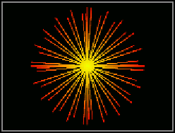
Example
Example: Indexed Line Set in VRML:
geometry IndexedLineSet {
coord Coordinate {
point [
0.00 0.00 0.00, 1.00 0.00 0.00,
0.92 0.38 0.00, 0.71 0.71 0.00,
0.38 0.92 0.00, 0.00 1.00 0.00,
-0.38 0.92 0.00, -0.71 0.71 0.00,
-0.92 0.38 0.00, -1.00 0.00 0.00,
-0.92 -0.38 0.00, -0.71 -0.71 0.00,
-0.38 -0.92 0.00, 0.00 -1.00 0.00,
0.38 -0.92 0.00, 0.71 -0.71 0.00,
0.92 -0.38 0.00,
]
}
coordIndex [
0, 1, -1, 0, 2, -1,
0, 3, -1, 0, 4, -1,
0, 5, -1, 0, 6, -1,
0, 7, -1, 0, 8, -1,
0, 9, -1, 0, 10, -1,
0, 11, -1, 0, 12, -1,
0, 13, -1, 0, 14, -1,
0, 15, -1, 0, 16, -1
]
}
Vertex list
Index list

Slide 14
Avoid modeling anomalies
Avoid T-join in your models
  E.g., three triangles T1(ABC), T2(ACD), and T3(BED)
  Edge BD of T3 may no longer touch point C after MV and Proj. transformations. Thus, you may see a hole at edge BD!!!
  Reason: computation is not exact with floating point numbers
A
A
T1
T2
Solution:
T1
T2
B
D
B
D
C
C
Break T3 into
two triangles
T31
T32
T3
E
E

Slide 15
Avoid modeling anomalies
2. Avoid overlapping polygons in your models
  E.g., two triangles T1(ABC) and T2(ABD) on same 3D plane
  If colors of T1 and T2 are different, you may see flipping colors in the overlapping area due to depth buffering precision and numeric error.
Another trick:
Turn off Depth
test when you
draw the next
triangle OR use
glPolygonOffset
(See hidden surface
removal lecture)
C
D
C
D
E
T1
Solution:
T2
T1
T2
T3
One more triangle
for the
overlapping area
A
B
A
B
Colors flips between R and G

Slide 16
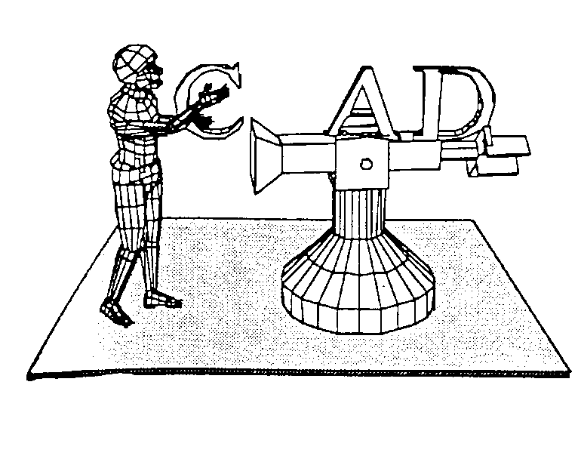
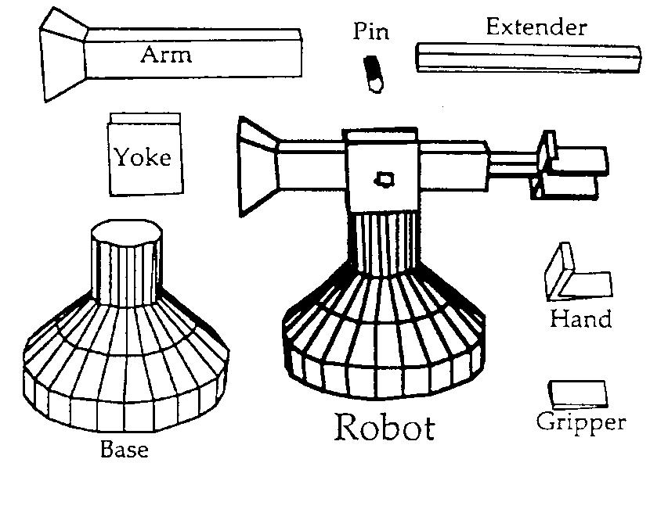
Hierarchical model
Human with Robot scene based on polyhedra. Note how the whole scene is composed of rectangles, trapezoids, or, in the case of the 3D letters, rectangles and n-sided polygons
Exploded view of hierarchical structure of robot. The robot main object (bold) is constructed by assembling graphical primitive subobjects which are easily generated by CAD systems

Slide 17
Hierarchical Model
Scene:
“Human with Robot”
Objects
Platform
Human
Robot
Letters
Head
Base
“C”
Hierarchical structure of a polyhedral scene. Note that each subobject will have its own polygon list and associated vertex list. Also, subobjects such as right arm will have its own subobjects such as upper arm, lower arm, and hand. The hand may, in turn, have subobjects such as a fingers, and so on.
Torso
Yoke
“A”
Sub-
Right Arm
Arm
“D”
Objects
Left Arm
Pin
Right Leg
Extender
Left Leg
Hand
Gripper
Vertex List
Polygon List
Vertex #
Coordinates
Gripper
1
x1,y,1z1
Polygon #
Vertex List
Data
2
x2,y2,z2
1
V1,V2,V3,V4
Structure
3
x3,y3,z3
2
V1,V4,V8,V5
4
x4,y4,z4
3
V5,V6,V2,V1
5
x5,y5,z5
4
V2,V6,V7,V3
6
x6,y6,z6
5
V4,V3,V7,V8
7
x7,y7,z7
6
V5,V8,V7,V6
8
x8,y8,z8

Slide 18
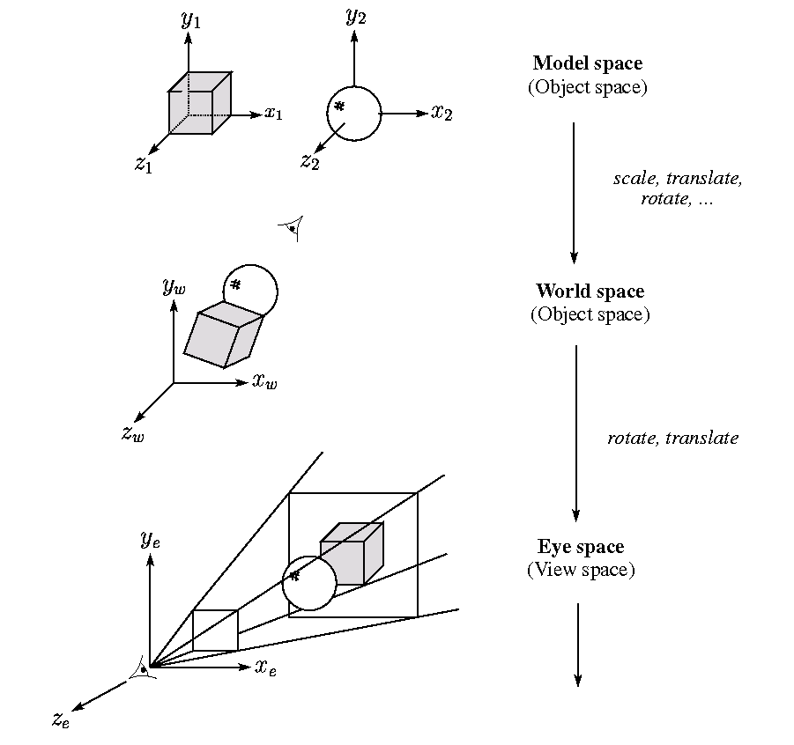
Model and view transformations
Given object
coordinate P_{obj} = (x,y,z)^{T}
Different objects
M_{obj2world}
World coord. = M_{obj2world} x P_{obj}
Common world
M_{world2eye}
Eye coord. =
M_{world2eye} x M_{obj2world} x P_{obj}
In front of
the Eye
……

Slide 19
OpenGL Modelview transformation
M_{obj2world} and M_{world2eye} are merged into one matrix,
called the modelview (or viewworld) matrix “M_{modelview}”
Given object
coordinate P_{obj} = (x,y,z)^{T}
An object
M_{modelview}
In front of
the Eye
Eye coord. = M_{modelview} x P_{obj}
……

Slide 20
OpenGL Modelview transformation
About the modelview matrix “M_{modelview}”
Important Note:
OpenGL puts the eye-point at the origin looking towards
negative z-axis
OpenGL is a state machine: it has a internal memory storage (4 x 4 floating point numbers) for the modelview matrix
By calling OpenGL functions glTranslate / glRotate / glScale, the kernel will first construct a matrix for the T/R/S and multiply it with the current modelview matrix

Slide 21
OpenGL Modelview transformation
Memory in
Graphics hardware
OGL
Commands
Kernel
Operations
Comment
Step 0
M_{modelview}
Initial value: an identity
Step 1
glTranslate
Construct M_{tran}
Construct a matrix for T
Step 2
M_{modelview}xM_{tran}
Multiply M_{tran} with M_{modelview}
Step 3
M_{modelview}xM_{tran}
Store the result

Slide 22
OpenGL Modelview transformation
Example:
glMatrixMode ( GL_MODELVIEW ) ;
glLoadIdentity () ;
glTranslatef ( ball_X , ball_Y , ball_Z ) ;
glRotatef ( ball_ang , ball_dirX , ball_dirY , ball_dirZ ) ;
glScalef ( ball_Sx , ball_Sy , ball_Sz ) ;
Draw_ball() ;
glLoadIdentity () ;
glTranslatef ( cube_X , cube_Y , cube_Z ) ;
glRotatef ( cube_ang , cube_dirX , cube_dirY , cube_dirZ ) ;
glScalef ( cube_Sx , cube_Sy , cube_Sz ) ;
Draw_cube() ;
M_{modelview}
……

Slide 23
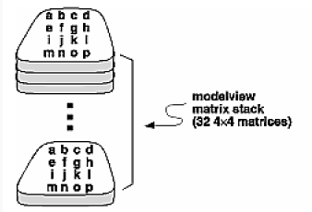
OpenGL Modelview tranformation (a stack)
Modelview matrix has a stack (normally 32 levels, depending on the hardware)
Example:
glMatrixMode ( GL_MODELVIEW ) ;
glLoadIdentity () ;
glPushMatrix() ;
glTranslatef ( ball_X , ball_Y , ball_Z ) ;
glRotatef ( ball_ang , ball_dirX , ball_dirY , ball_dirZ ) ;
glScalef ( ball_Sx , ball_Sy , ball_Sz ) ;
Draw_ball() ;
glPopMatrix() ;
glPushMatrix() ;
glTranslatef ( cube_X , cube_Y , cube_Z ) ;
glRotatef ( cube_ang , cube_dirX , cube_dirY , cube_dirZ ) ;
glScalef ( cube_Sx , cube_Sy , cube_Sz ) ;
Draw_cube() ;
glPopMatrix() ;
Modelview
matrix stack
(32 4x4 matrices)
Note:
OGL kernel apply the topmost matrix to the object coordinate (input of glVertex)
Beware: (i) glPushMatrix and glPopMatrix should be used in pair and (ii) stack underflow or overflow
Topmost modelview matrix reverts to an Identity

Slide 24
OpenGL Modelview transformation (a stack)
Example:
glMatrixMode ( GL_MODELVIEW ) ;
glLoadIdentity () ;
glPushMatrix() ;
glTranslatef ( ball_X , ball_Y , ball_Z ) ;
glRotatef ( ball_ang , ball_dirX , ball_dirY , ball_dirZ ) ;
glScalef ( ball_Sx , ball_Sy , ball_Sz ) ;
Draw_ball() ;
glPopMatrix() ;
glPushMatrix() ;
glTranslatef ( cube_X , cube_Y , cube_Z ) ;
glRotatef ( cube_ang , cube_dirX , cube_dirY , cube_dirZ ) ;
glScalef ( cube_Sx , cube_Sy , cube_Sz ) ;
Draw_cube() ;
glPopMatrix() ;
Construct M_{world2eye} at the beginning
M_{obj2world}
Construct M_{obj2world}
M_{world2eye}
Construct M_{obj2world}
M_{world2eye} x M_{obj2world} x P_{obj}

Slide 25
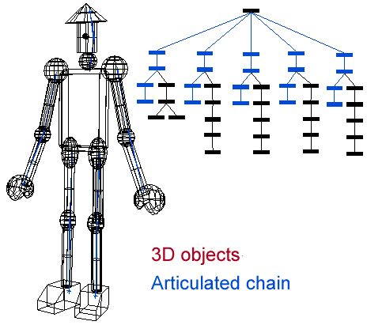
Hierarchical model (a stack of transformations)
Notes:
http://www.youtube.com/watch?v=P4JzUvxtMpg

Slide 26
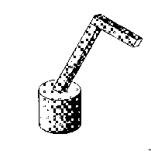
OpenGL Modelview transformation
Example: A robot arm
Consider this robot arm with 3 degrees of freedom (D.O.F.):
1. Base rotates about its vertical axis by θ
2. Lower arm rotates in its xy-plane by φ
3. Upper arm rotates in its xy-plane by ψ
Q: What is the tree structure of the robot?
Q: What matrix do we use to transform the base?
Q: What matrix for the lower arm?
Q: What matrix for the upper arm?
Y
Y
Y
φ
ψ
X
X
X
θ
Z
Z
Z

Slide 27
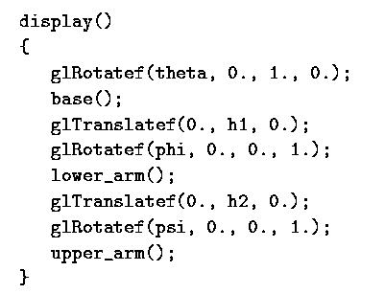
OpenGL Modelview transformation
Example: A robot arm
Consider this robot arm with 3 degrees of freedom (D.O.F.):
1. Base rotates about its vertical axis by θ
2. Lower arm rotates in its xy-plane by φ
3. Upper arm rotates in its xy-plane by ψ
Y
Y
Y
φ
ψ
Any error here?
X
X
X
θ
Z
Z
Z

Slide 28
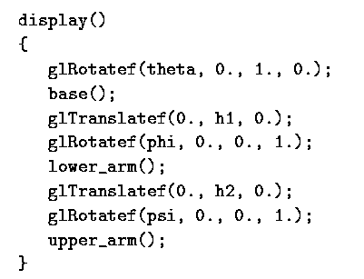
OpenGL Modelview transformation
Error 1
glPushMatrix
Note:
A good practice: we should properly enclose
glTranslate, glRotate, etc. with glPushMatrix
and glPopMatrix
Because OGL is a state machine, changes to
the modelview matrix is permanent and if we
call display() twice, we will end up with a
strange transformation the next time.
glPopMatrix
Error 2
Since eye is at the origin, we cannot see the object

Slide 29
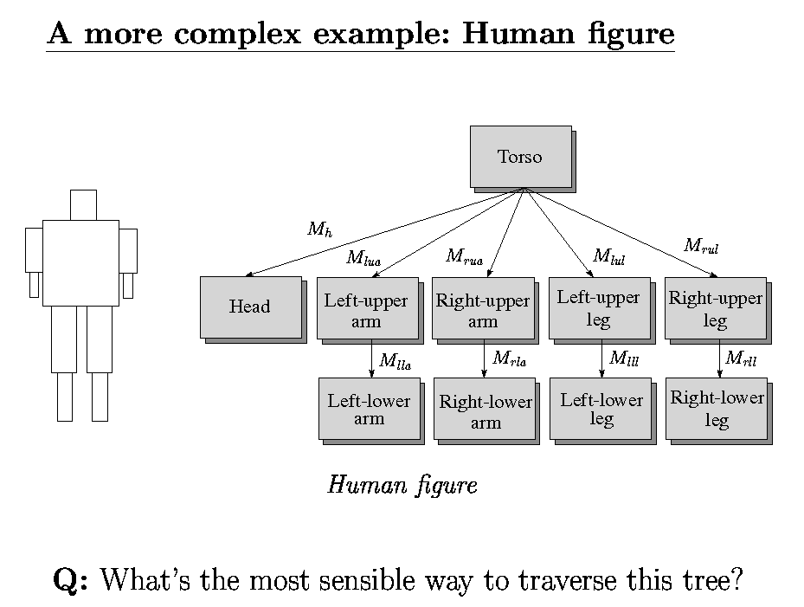
OpenGL Modelview transformation

Slide 30
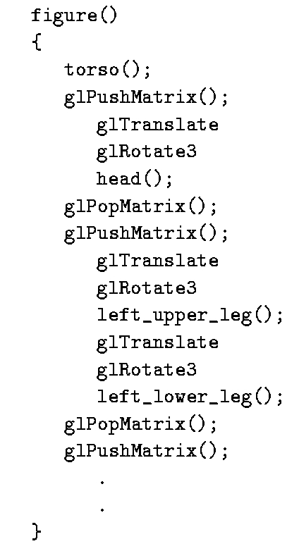
OpenGL Modelview transformation
Notes:
http://www.youtube.com/watch?v=q54fbMvl3GE

Slide 31
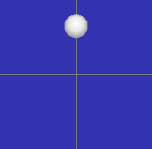
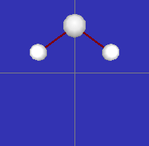
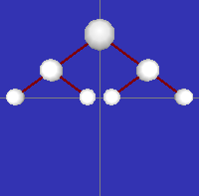
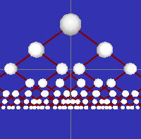
Recursive Hierarchical Modeling
You build your hierarchical objects as C++ classes.
  That means that you could make an instance of your object a child of another instance of your object.
  You could potentially build a chain of nested instances of your object, each inheriting from the next.

Slide 32
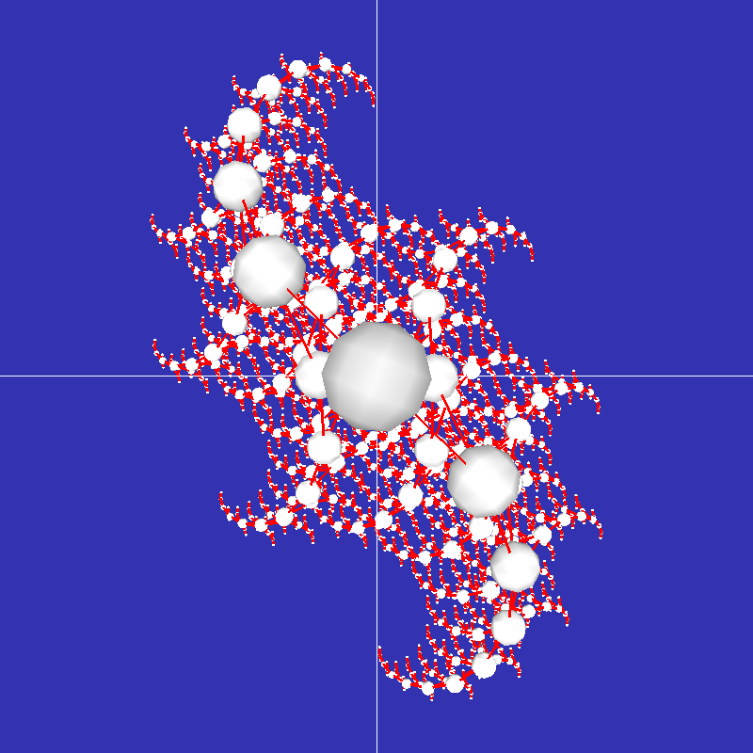
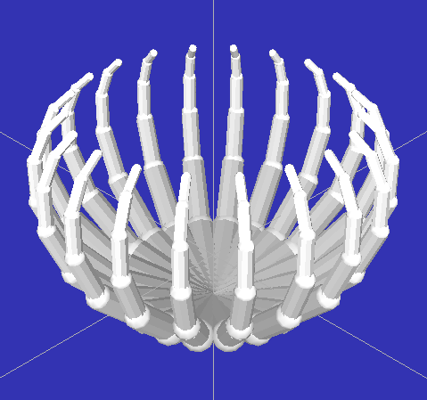
Recursive Hierarchical Modeling
By applying small transforms to every level of your scene graph, a recursive model can quickly generate some
amazing images.

Slide 33
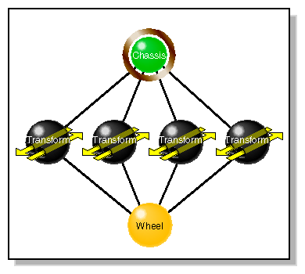
Basic scenegraph concept
Organize the whole model hierarchy (the geometry as well as
the lighting, material, camera, etc.) as a graph structure
Examples (API/Language): VRML, OpenGL Inventor, OpenGL
Performer, OpenSG (open scenegraph), etc.
For example:
Two most general classifications of node functionality are:
Group nodes - associate nodes into hierarchies.
Leaf nodes - contain all the descriptive data of objects in the
virtual world used to render them.
* Reuse the wheel geometry

Slide 34
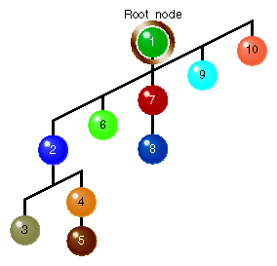
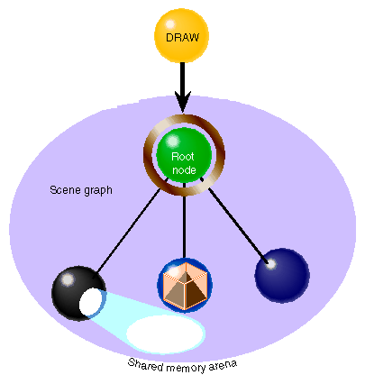
Basic scenegraph concet
The renderer (VRML / OpenGL Performer / Inventor ) traverses
the tree: add light source, apply material attributes, render geometry etc.
Traversal order
[OGL Performer
Programming Guide]

Slide 35
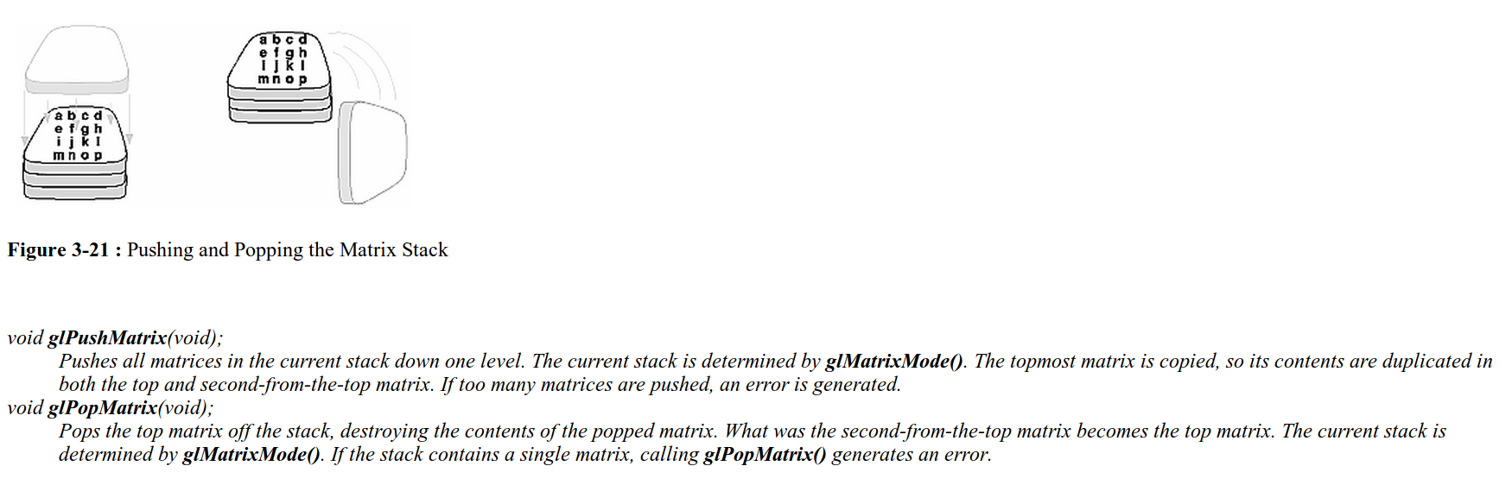
Further reference: glPushMatrix() and glPopMatrix()
The Red Book (see “Manipulating the Matrix Stack”, very clear description):
http://www.glprogramming.com/red/chapter03.html#name6
Quoted from the Red Book:

